Slide 1
Hacker Techniques, Tools, and Incident Handling
Chapter 1
Hacking: The Next Generation

Slide 2
Learning Objective
Explore the history and current state of hacking and penetration testing, including their ethical and legal implications.

Slide 3
Key Concepts
Motives of hackers
History of hacking
Ethical hacking and penetration testing
Laws and ethical standards for penetration testers and ethical hackers

Slide 4
Profiles and Motives of Different Types of Hackers
Good guys are InfoSec professionals who use hacking skills to expose vulnerabilities and makes their systems more secure
Amateurs are entry-level hackers who use scripts and software from experienced hackers
Criminals are hackers who conduct illegal activities for financial gain
Ideologues are hackers who conduct hacking activities for political or ideological goals

Slide 5
TAP Principle of Controls
Technical
Software or hardware devices, such as firewalls and biometrics, and permissions
Administrative
Policies and procedures
Physical
Doors, locks, cameras, security guards, lighting, fences, gates, and similar devices

Slide 6
The Hacker Mindset
Victimless crime
Robin Hood ideal
National pride and patriotism
Educational value
Curiosity
Notes:
Victimless crime — Because humans are not the direct targets, there’s nothing wrong with committing the crime. (Of course, this justification doesn’t apply to attacks that actually do target individuals.)
Robin Hood ideal — Stealing software and other media from “rich” companies and delivering them to the “poor” consumers via methods such as BitTorrent is okay because the target companies have plenty of money.
National pride and patriotism — Patriotic hackers may seek to upset the balance of national power, hacking to disrupt the due process of an adversary and/or bolster the opinion of their own country.
The educational value of hacking — Essentially, it is okay to commit a crime as long as one is doing it to learn.
Curiosity: Breaking into a network is okay as long as you don’t steal or change anything.

Slide 7
Motivations
Means
Motive
Opportunity
Notes:
Means — Does the attacker possess the ability to commit the crime in question?
Motive — Does the attacker have a reason to engage in the commission of the crime?
Opportunity — Does the attacker have the necessary access and time to commit the crime?

Slide 8
Motivations (Cont.)
Beneficial contribution
Monetary gain
Status
Ideology/Hacktivist
Notes:
Beneficial contribution — Hackers with this motive are not criminals. White-hat hackers, or ethical hackers, are InfoSec professionals who engage in hacking activities to help make their organization’s systems more secure.
Status/validation — New hackers with limited original skills are generally referred to as script kiddies. They run prepackaged scripts and programs written by more experienced hackers. Many of today’s hackers start out to make a name for themselves.
Monetary gain — Most of today’s malicious attacks are specifically targeted to either generate revenue for the attacker or deny revenue to the target. These hackers can include malicious insiders, individual criminals, organized crime organizations, or cybermercenaries.
Ideology — Hackers with this motive use technology to achieve ideological goals. Hackers that use malicious software to carry out activist attacks are referred to as hacktivists. Nationalists and nation-state actors are also motivated by ideology.

Slide 9
History of Computer Hacking
Mainframe hacking
Worms and viruses released on PCs
First website defacements
Malicious hacking greatly increased for financial gain
2000s
1990s
1980s
1970s

Slide 10
Modern Hacking and Cybercriminals
New threats in the form of worms, spam, spyware, adware, and rootkits
Shift from lone hacker to groups of hackers
Crime rings, organized crime, and nations with hostile interests use the Internet as an attack route -- cyberattacks
Hackers receive financing from criminal organizations, terrorists, or even foreign governments

Slide 11
Ethical Hacking and Penetration Testing
Ethical hackers require permission to engage in penetration testing
Penetration testing is the structured and methodical means of investigating, uncovering, attacking, and reporting on a target system’s strengths and vulnerabilities
Penetration tests are commonly part of IT audits

Slide 12
Ethical Hacking and Penetration Testing (Cont.)
Black-box Testing
Used to simulate how attacker views system
White-box Testing
Advanced knowledge provided to testing team
No knowledge of system provided to testing team

Slide 13
Role of Ethical Hacking
Ethical Hacking
Understand hacker mindset
Simulate attacks
Use knowledge and skills

Slide 14
Role of Ethical Hacking (Cont.)
Key Points
Requires permission of victim
Use same strategies as malicious hacker
Establish rules of engagement
Use care to avoid harming system
Need advance knowledge of hacker techniques

Slide 15
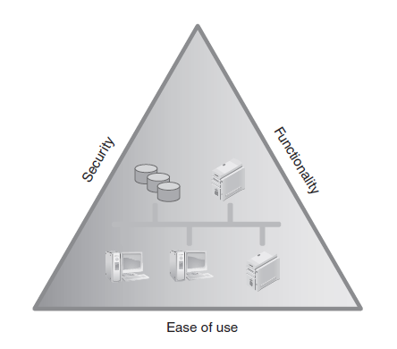
Ethical Hackers and the C-I-A Triad: Usability vs. Security

Slide 16
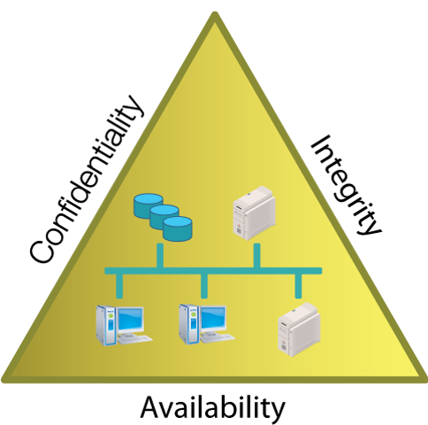
Ethical Hackers and the C-I-A Triad: The C-I-A Triad
Notes:
Confidentiality — Ensuring that only authorized subjects can access protected data
Integrity — Ensuring that only authorized subjects can modify protected data
Availability — Ensuring that information and the resources that manage information are available on demand to authorized subjects
An ethical hacker must strive to maintain the integrity of C-I-A and not let any of the elements of the anti-triad occur:
Disclosure — Information is accessed in some manner by an unauthorized subject.
Alteration — Information is maliciously modified by an unauthorized subject or accidentally modified in some harmful manner by an authorized subject.
Disruption — Information and/or services are not accessible or usable when called upon by authorized subjects.

Slide 17
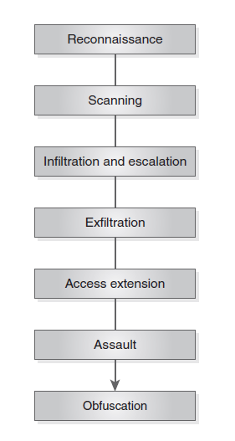
Common Hacking Methodologies: Hacking Steps
Notes:
Reconnaissance — An attacker passively acquires information about the intended victim and/or the intended victim’s systems.
Scanning — An attacker takes the information obtained during the reconnaissance phase and uses it to actively acquire more detailed information about a victim.
Infiltration and escalation — An attacker uses info gathered during the scanning phase to attempt to exploit identified vulnerabilities.
Exfiltration — An attacker gains elevated or unrestricted access to an environment where they can then access protected data, resources, and information.
Access extension — Attackers install additional exploits (rootkits or other tools) so that they can continue to access the system in the future.
Assault — The assault phase is not presented in all types of attacks but when present, this is the destructive phase where attackers who want to cause damage do so.
Obfuscation — This phase is where an attacker uses their elevated privileges to cover their tracks and erase traces of their presence in the system. Not all attackers exercise this option.

Slide 18
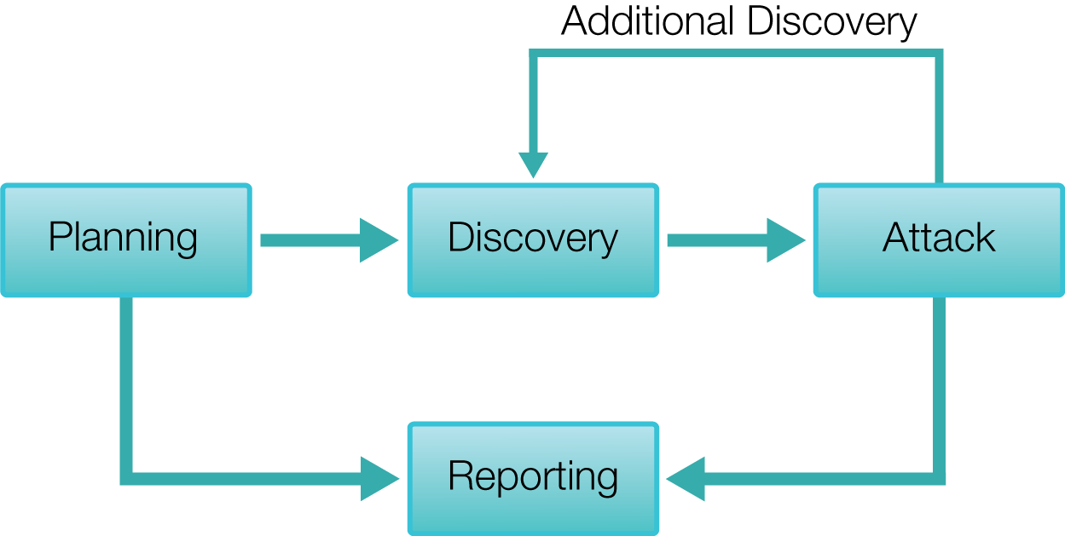
Performing a Penetration Test: Ethical Hacking Steps

Slide 19
Performing a Penetration Test (Cont.)
Types of Penetration Test Attacks
Technical
Administrative
Physical
Notes:
Tests that can be part of a penetration test include the following:
Technical attack — Designed to simulate an attack against technology from either the inside or the outside depending on the goals and intentions of the client.
Administrative attack — Designed to find loopholes or shortcomings in how tasks and operational processes are performed.
Physical attack — Includes anything that targets physical equipment and facilities with actions such as theft, breaking and entering, or similar actions. Can also include actions against people, such as social engineering–related threats.

Slide 20
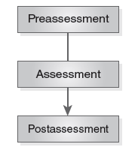
Ethical Hacking Test Steps
Notes:
After an organization and the ethical hacker have discussed each test, determined its suitability, and evaluated its potential advantages and side effects, they can finalize the planning and contracts and perform the testing.

Slide 21
Laws and Ethical Standards
Trust
Client places trust in ethical hacker to use proper discretion when performing tests
Legal implications
Violating limits defined by the permitted scope of testing may be sufficient cause for client to take legal action against ethical hacker
If ethical hacker breaks trust, can degrade trust in other project aspects, such as the reported results of tests
If violating test scope results in damages, client may be compelled to take legal action

Slide 22
Laws and Ethical Standards (Cont.)
Examples of laws and ethical standards:
Computer Fraud and Abuse Act
US Electronic Communications Privacy Act
Sarbanes-Oxley Act (SOX)
Federal Information Security Modernization Act (FISMA 2014)
Notes:
1986 (amended in 1996) US Computer Fraud and Abuse Act includes issues such as altering, damaging, or destroying information in a federal computer and trafficking in computer passwords if it affects interstate or foreign commerce or permits unauthorized access to government computers.
1986 US Electronic Communications Privacy Act prohibits eavesdropping or the interception of message contents without distinguishing between private and public systems.
2002 Sarbanes-Oxley Act (SOX) is a corporate governance law that affects public corporations’ financial reporting. Under SOX, corporations must certify the accuracy and integrity of their financial reporting and accounting.
2014 Federal Information Security Modernization Act (FISMA 2014) updates requirements placed by FISMA 2002, particularly surrounding the Department of Homeland Security authority. This act amends OMB oversight over InfoSec practices and seeks to reduce “inefficient and wasteful reporting” to the OMB.

Slide 23
Summary
Motives of hackers
History of hacking
Ethical hacking and penetration testing
Laws and ethical standards for penetration testers and ethical hackers

